Slide 1

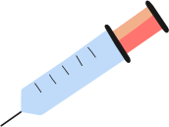



IRIS TUMOR DETECTION
USING CNN
PROJECT DEVELOPMENT
CONCLUSION
OUTPUTS
DATASETS
CNN
INTRODUCTION
Presented by:
GROUP – 03
JAGU MANISH
MANASA NAGOTHU
NAGA SAI CHILUKOTI
PERAVALI SUDHEER KUMAR
SAI KAMAL
DHANSHRI PRANIL CHAUDHARI

Slide 2

PROBLEM STATEMENT:
Iris tumor detection is a critical diagnostic task in ophthalmology, aiming to identify whether an individual has a tumorous or healthy iris. Early detection of iris tumors can help in timely intervention, preventing potential vision loss or life-threatening complications. With the advancement of deep learning, Convolutional Neural Networks (CNNs) have proven effective in image classification and medical diagnosis tasks, making them an ideal approach for automating iris tumor detection.
Objective
To develop an automated system using Convolutional Neural Networks (CNNs) that can classify iris images into two categories:
Healthy Iris
Tumored Iris
Proposed Solution
A Convolutional Neural Network (CNN) will be designed and trained on labeled iris images. The network will learn to extract features and classify images into the respective categories.
CONCLUSION
INTRODUCTION
OUTPUTS
DEVELOPMENT
DATASETS
ABSTRACT

Slide 3
Applications
Assisting ophthalmologists with preliminary screening.
Reducing manual workload in diagnosing iris tumors.
Providing a second-opinion tool for rural or under-resourced areas.
Expected Impact
Improved accuracy and speed in iris tumor diagnosis.
Enhanced early detection capabilities, reducing severe medical consequences.
Greater accessibility to diagnostic tools for underserved populations.
Performance Metrics:
Accuracy
Precision
F1 Score
CONCLUSION
INTRODUCTION
OUTPUTS
DEVELOPMENT
DATASETS
ABSTRACT

Slide 4
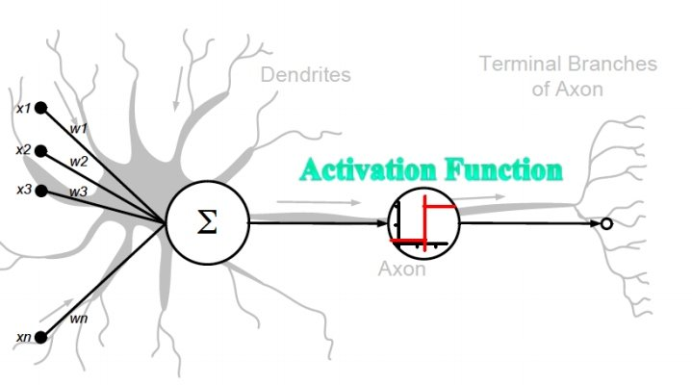
Introduction to CNN
A Convolutional Neural Network (CNN) is a type of deep learning algorithm designed to process and analyze visual data. CNNs are highly effective in recognizing patterns in images and videos and are widely used in computer vision tasks such as image classification, object detection, facial recognition, and more. They are inspired by the structure of the visual cortex in the human brain, which processes visual input hierarchically. CNNs are particularly powerful because they can automatically and adaptively learn spatial hierarchies of features from input images. Unlike traditional machine learning methods, CNNs do not require manual feature extraction, making them a key innovation in deep learning.
Overview Of CNN
CNNs leverage three main concepts to process images:
Local Receptive Fields: The network processes small regions of the input image at a time (e.g., 3x3 or 5x5 pixel regions) to capture spatial features.
Shared Weights (Convolution): A set of filters (or kernels) is used across the image to detect patterns such as edges, corners, or textures. These filters are "shared," reducing the number of parameters.
Pooling (Downsampling): Pooling layers reduce the spatial
dimensions of the image, retaining the most critical features
while reducing computational complexity.
CONCLUSION
INTRODUCTION
OUTPUTS
DEVELOPMENT
DATASETS
CNN

Slide 5
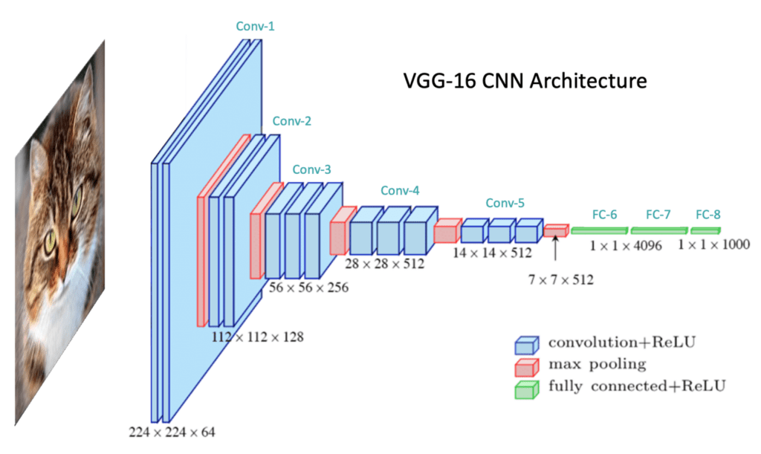
Architecture of CNN
The architecture of a CNN generally consists of a sequence of the following layers:
Convolutional Layer (Conv Layer):
Applies convolution operations using filters to detect features such as edges, textures, or patterns.
Example: A 3x3 filter sliding over a 28x28 image creates a feature map by computing dot products.
ReLU Activation:
Introduces non-linearity by applying the function f(x)=max(0,x)f(x) = \text{max}(0, x)f(x)=max(0,x).
Ensures the model can learn complex patterns.
Pooling Layer:
Reduces the size of the feature map (e.g., max pooling selects the maximum value in a region).
Common pooling types: Max Pooling, Average Pooling.
Flattening:
Converts the 2D feature maps into a 1D vector to prepare for fully
connected layers.
Fully Connected Layer:
Dense layers that perform high-level reasoning based on the
extracted features.
Output Layer:
Produces the final result, often using a softmax activation
for classification tasks.
CONCLUSION
INTRODUCTION
OUTPUTS
DEVELOPMENT
DATASETS
CNN

Slide 6
APPLICATUINS OF CNN
Image Processing
Object Detection: Models like YOLO and Faster R-CNN detect objects in images for applications like security systems and autonomous vehicles.
Image Classification: Categorizing images into classes (e.g., cat vs. dog) using models like ResNet or VGG.
Image Segmentation: Partitioning images into meaningful regions, used in autonomous driving (lane detection) and medical imaging (tumor segmentation).
Face Recognition: Facial feature detection for security (e.g., Face ID, attendance systems).
Medical Imaging
Disease Diagnosis: Detecting diseases from X-rays, MRIs, CT scans, and histopathology images (e.g., tumor detection, pneumonia classification).
Retinal Analysis: Identifying diabetic retinopathy or glaucoma from retinal scans.
Autonomous Vehicles
Lane Detection: Identifying lanes and obstacles for self-driving cars.
Traffic Sign Recognition: Reading and interpreting road signs.
Pedestrian Detection: Ensuring safety in traffic environments.
CONCLUSION
INTRODUCTION
OUTPUTS
DEVELOPMENT
DATASETS
CNN

Slide 7
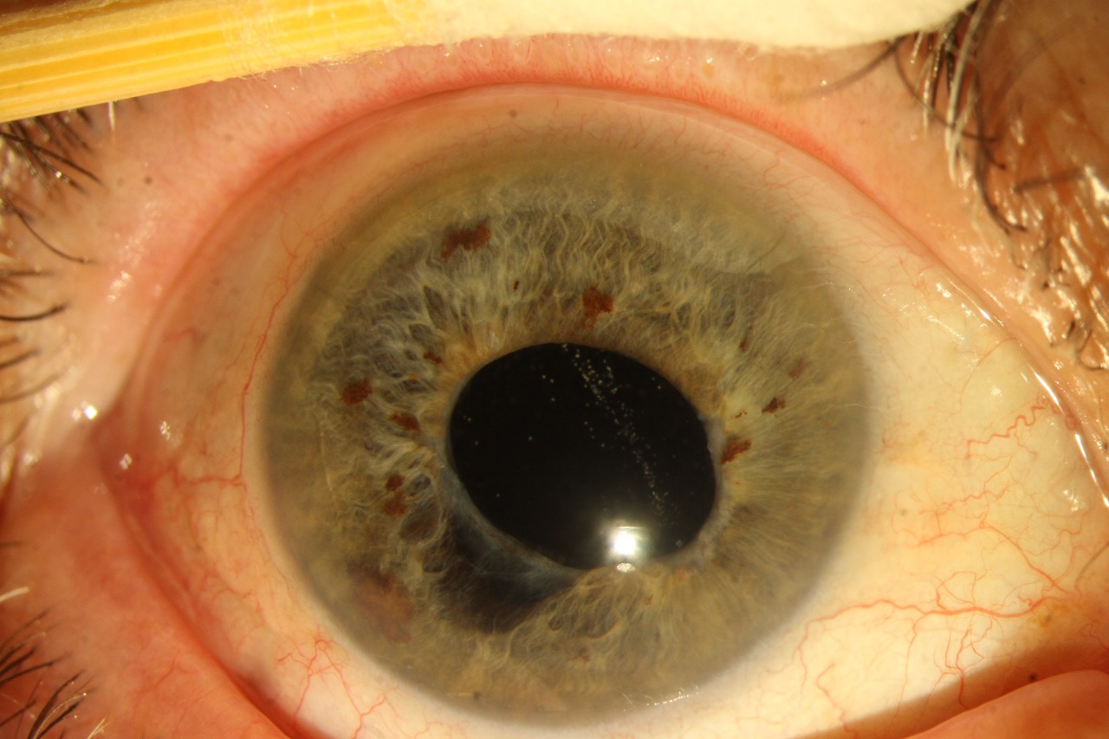
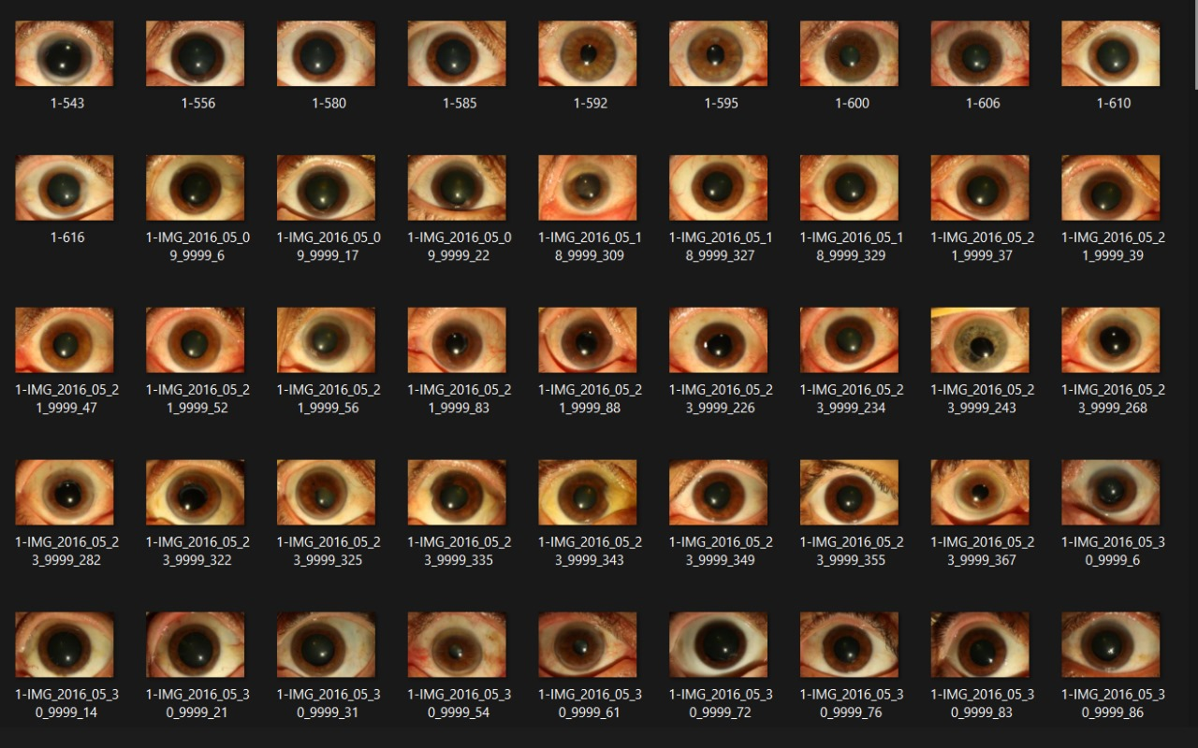

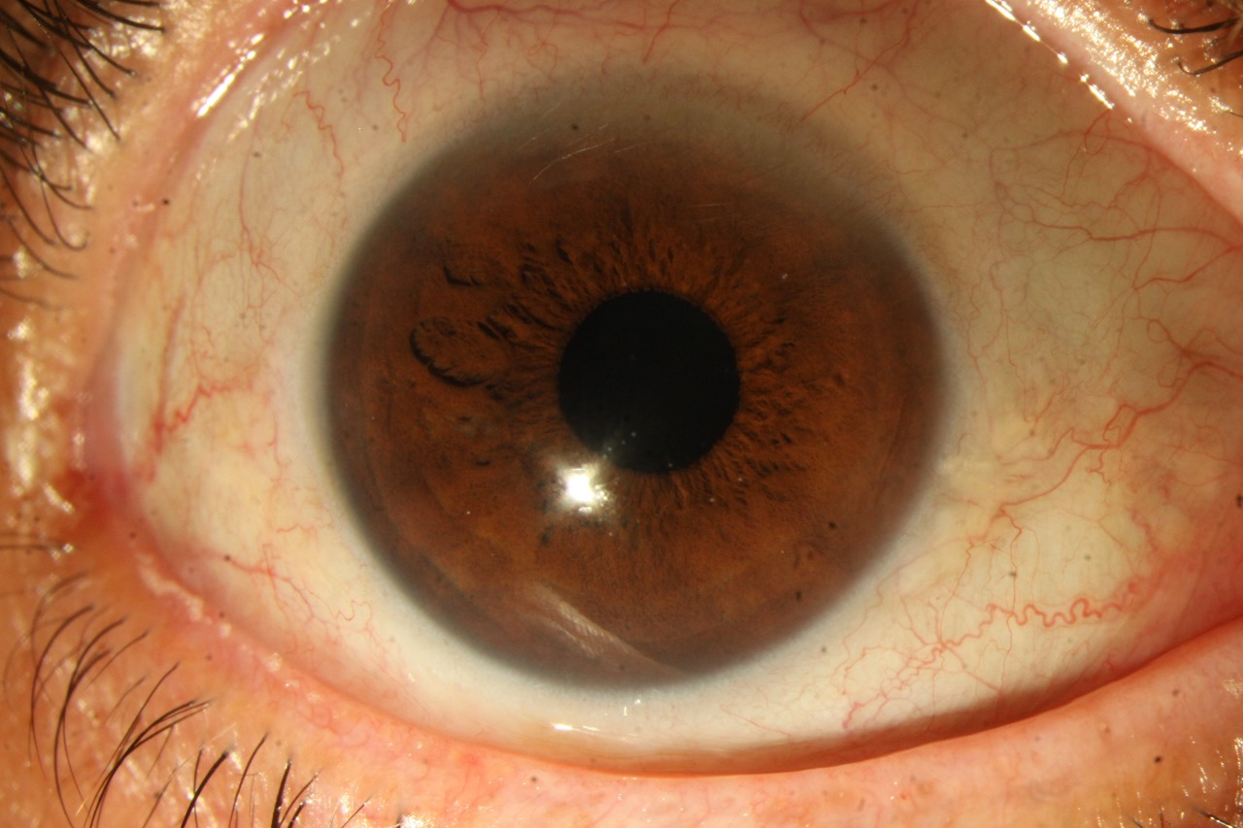
Dataset Preparation
Dataset Collection: Collect a dataset of iris images with annotations for tumor presence and type. Public datasets might be available, or you may need to annotate images manually.
Preprocessing:
Resize images to a consistent size (e.g., 128x128 or 224x224 for CNNs).
Normalize pixel values to the range [0, 1]
Augment the dataset (e.g., flipping, rotation, brightness adjustment) to improve generalization.
Split the dataset into training, validation, and test sets.
CONCLUSION
INTRODUCTION
OUTPUTS
DEVELOPMENT
DATASETS
CNN
Tumored
Label - 1
Healthy
Label - 0

Slide 8

Z
STEPS FOR DEVELOPING OF IRIS TUMOUR DETECTION MODEL USING CNN
1. Problem Definition: Define the objective of detecting tumors in iris images. 2. Data Collection: Gather a labeled dataset of normal and tumorous iris images. 3. Data Preprocessing: Resize, normalize, augment, and encode the dataset for training. 4. Designing the CNN Architecture: Build a CNN model with convolution, pooling, and fully connected layers. 5. Training the Model: Train the model using a loss function, optimizer, and evaluation metrics. 6. Model Evaluation: Assess the model’s accuracy, precision, recall, and ROC-AUC on test data. 7. Deploying the Model: Convert and deploy the model for real-world use in applications.
CONCLUSION
INTRODUCTION
OUTPUTS
DEVELOPMENT
DATASETS
CNN

Slide 9


Z
TOOLS REQUIRED FOR THE MODEL
1. Development Environment
- Jupyter Notebook: For interactive coding and visualization.
2. Programming Language
- Python: Primary language for building and training the CNN model.
3. Core Python Libraries
- NumPy: For numerical operations and matrix handling.
- Pandas: For data manipulation and preprocessing.
- Matplotlib & Seaborn: For data visualization.
4. Machine Learning and Deep Learning Libraries
- TensorFlow or PyTorch: Frameworks to build and train the CNN model.
- Keras: For an easier interface to implement CNNs (comes with TensorFlow).
- scikit-learn: For preprocessing, splitting datasets, and evaluation metrics.
5. Image Processing Tools
- OpenCV: For image preprocessing (resizing, normalization, and augmentation).
- Pillow (PIL): For basic image handling.
- Albumentations: For advanced image augmentation.
6. Data Sources and Datasets
- Image Dataset: Ensure you have a labelled dataset with clear tumour vs. non-tumour classes. Datasets can be in JPEG, PNG, or similar formats.
- Data Splitting: Prepare training, validation, and testing sets.
CONCLUSION
INTRODUCTION
OUTPUTS
DEVELOPMENT
DATASETS
CNN

Slide 10
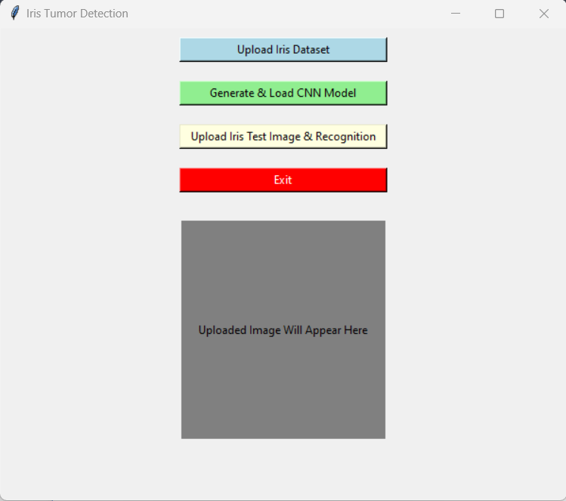
CONCLUSION
OUTPUTS
INTRODUCTION
DEVELOPMENT
DATASETS
CNN

Slide 11
Conclusion:
The CNN-based model successfully detected and classified iris tumors with high accuracy.
It demonstrated the potential of deep learning in medical image analysis, offering a reliable tool for early tumor detection.
The system can be used for automated diagnosis, reducing the workload on healthcare professionals and increasing diagnostic efficiency.
Future Scope:
Further improvement in model accuracy by incorporating more diverse and larger datasets.
Real-time tumor detection in clinical settings for faster diagnosis.
Integration of CNN with other AI techniques like transfer learning and reinforcement learning for enhanced performance.
Exploration of different imaging techniques (e.g., MRI, CT scans) for broader tumor detection applications.
CONCLUSION
INTRODUCTION
OUTPUTS
DEVELOPMENT
DATASETS
CNN
THANK YOU

Slide 12
This HR Analytics Dashboard serves as a critical tool for HR managers, enabling them to:
Identify patterns of employee attrition by department, role, and demographics.
Understand the impact of factors like job satisfaction, income, and business travel on retention.
Develop data-driven strategies to improve employee engagement, retention, and workforce management.
By leveraging the insights provided, HR teams can address key challenges, optimize employee satisfaction, and strengthen organizational performance.
THANK YOU !
CONCLUSION
INTRODUCTION
OUTPUTS
DEVELOPMENT
DATASETS
CNN

